Slide 1

S.C. Machro Technology S.R.L. - Expertise in High-Precision Processing
BRASOV, ROMANIA

Slide 2
About Us
Founded in 2018 in Brasov, Romania, S.C. Machro Technology S.R.L. is a high-precision processing company with 100% Romanian capital, specializing in the machining of aluminum alloys, steel and non-ferrous materials. With a strong portfolio of international clients and modern equipment, we are a trusted partner for companies in Germany, Switzerland, and France, serving critical sectors such as pharmaceuticals, aerospace, and marine.

Slide 3
Our Team – A Key Success Factor
We strongly believe that our team is a critical external factor in achieving our goals. The dedication, professionalism, and technical expertise of our employees have been essential in meeting the highest standards and delivering exceptional results across all our projects.

Slide 4

Our Vision
We aim to be a leader in high-precision processing, delivering high-quality solutions to international standards. Our philosophy is focused on two main pillars:
Quality: Through constant investments in state-of-the-art technology and an ISO 9001-certified quality control system, we ensure products that meet our clients' requirements.
Trusted Partnerships: We collaborate with top firms across various industries, ensuring that each project is completed on time and meets the strictest precision standards.

Slide 5
Technological capabilities
We have modern equipment acquired between 2018 and 2022, allowing us to tackle a wide range of complex projects:
Victor Center P106: Active stroke X-axis – 1060 mm, Y-axis – 600 mm
Victor Center P76: Active stroke X-axis – 760 mm, Y-axis – 500 mm
These vertical milling centers enable us to provide customized solutions tailored to each client's specific needs, regardless of project complexity.

Slide 6
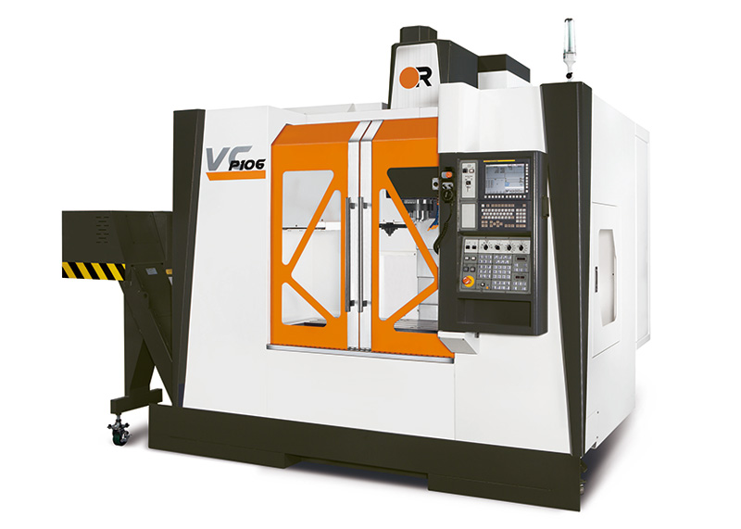
VC P106 and VC P76 processing possibilities
VC P106
*active stroke axis X 1060mm
active stroke axis Y 600mm
VC P76
* active stroke axis X 760mm
* active stroke axis Y 500mm

Slide 7
Materials and Processing Technologies
We specialize in machining a variety of materials, including:
ALUMINUM STEEL and STAINLESS STEEL
*2007 AlCuMgPb
*2017 ALCuMg1
*5083 AlMg4.5Mn
*5754 AlMg3`
*6060 AlMgSi0.5
*6082 AlMgSi1
*7075 AlZnMgCu1.5
POLYAMIDE
NON-FERROUS MATERIAL
*Brass, Copper, Bronze

Slide 8
Surface treatment made
We also offer a complete range of surface treatments, including hard anodizing (30-50 microns), sandblasting, and laser marking, allowing us to guarantee both durability and aesthetics of produced parts.

Slide 9
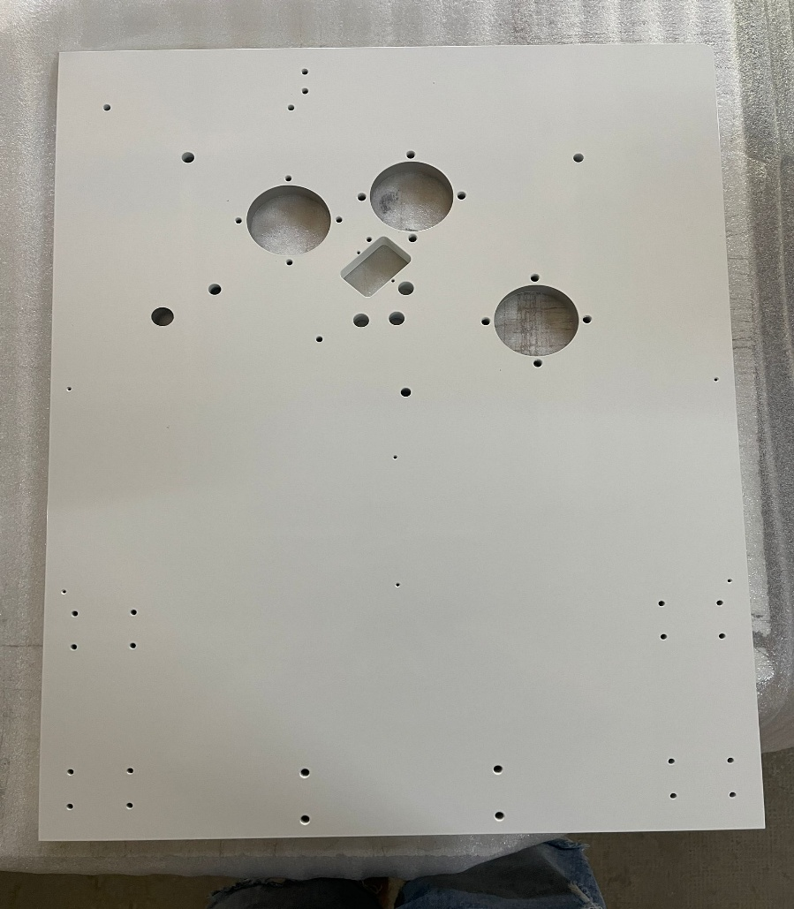
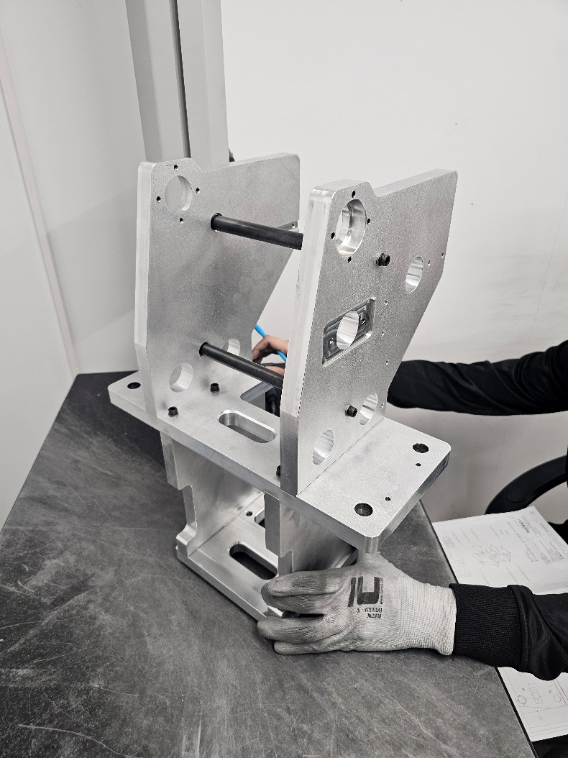
Mechanical assembly parts
Painted parts

Slide 10
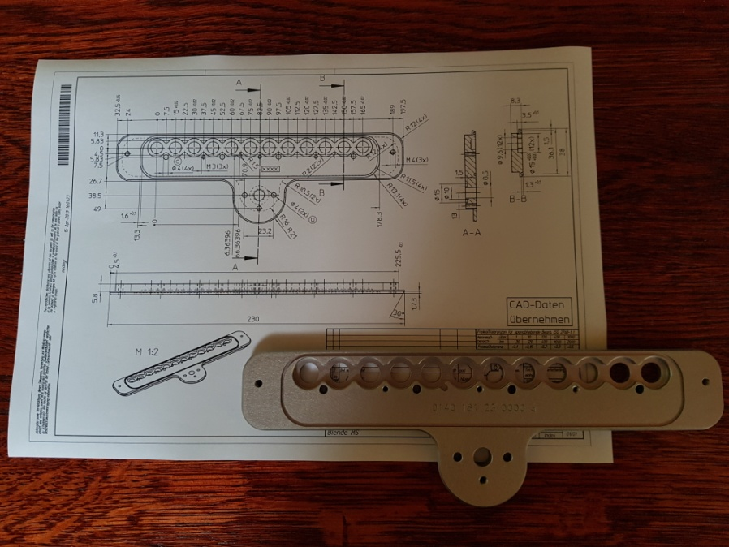
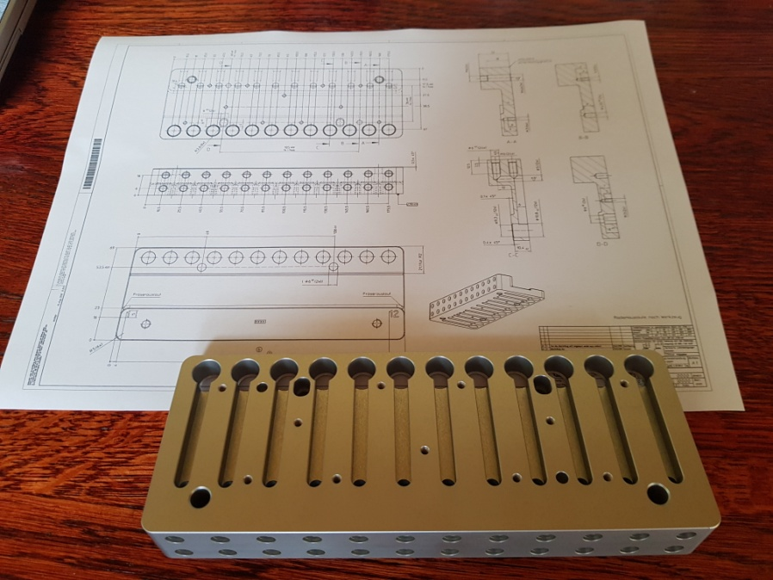
Al 5083 - colourless anodising
Al 5083 – colourless anodising

Slide 11
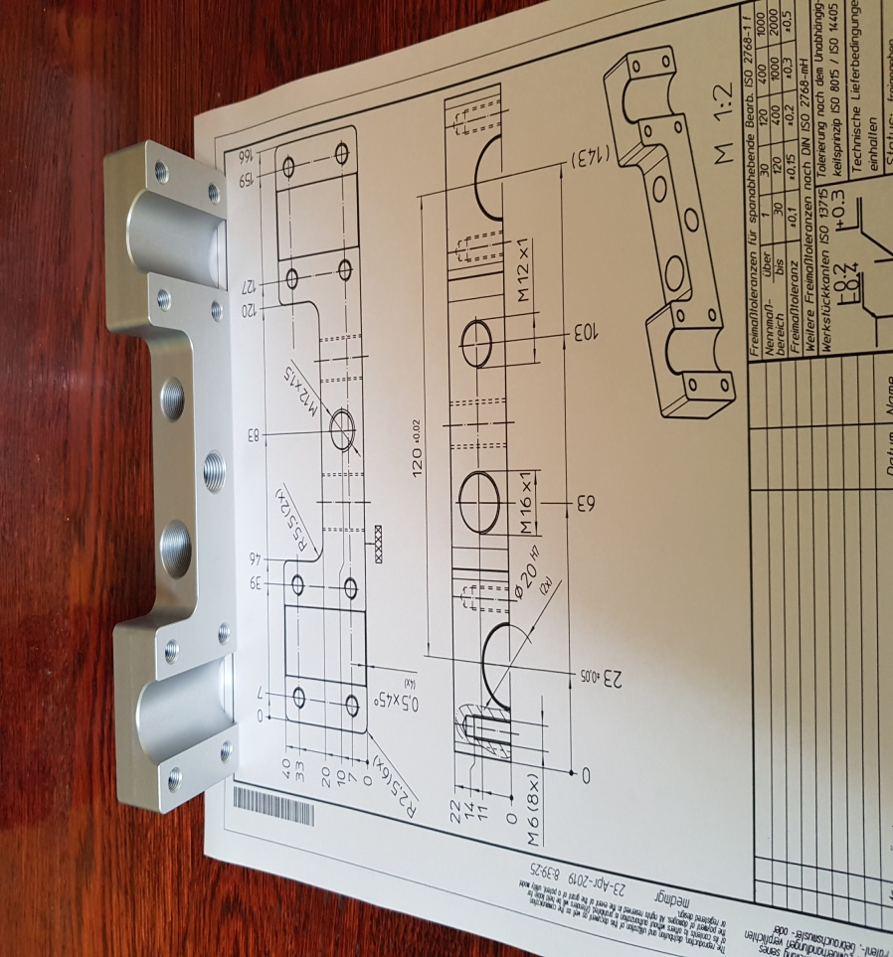
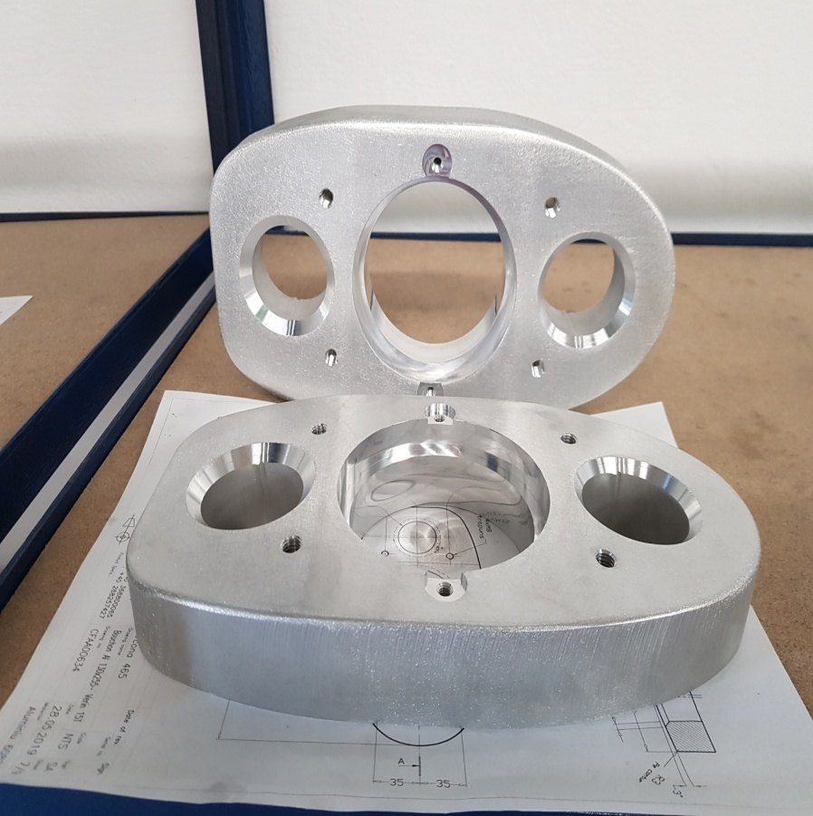
Al 5083 – colourless anodising
Al 6082

Slide 12
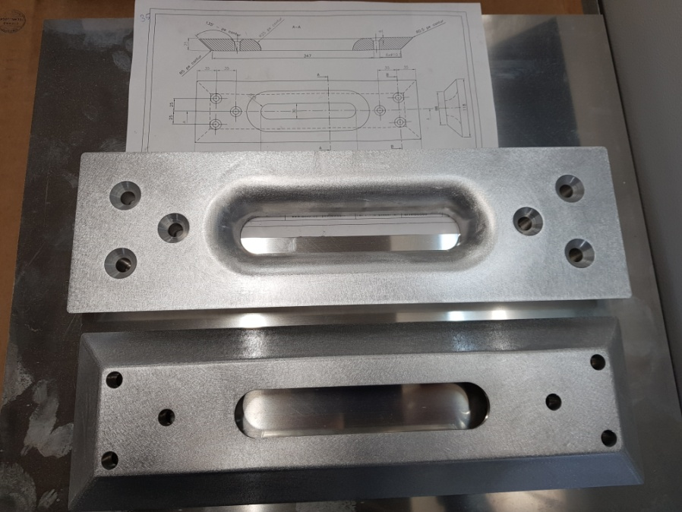
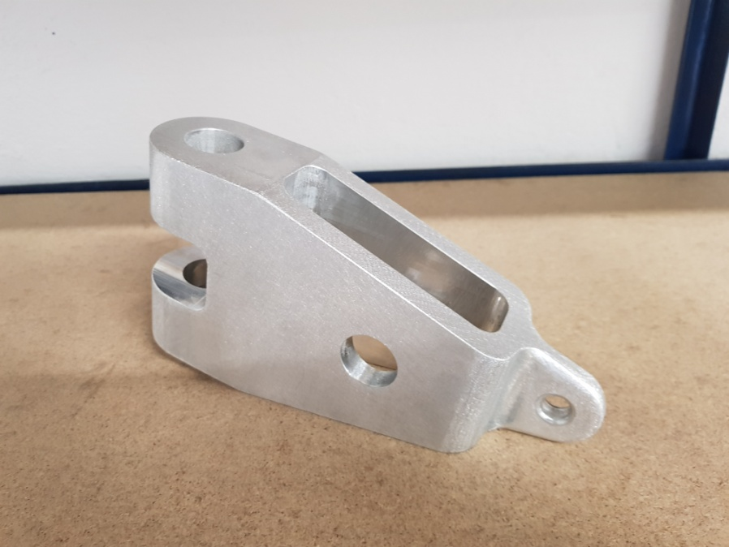
Al 6082
Al 6082

Slide 13
Innovation and Continuous Development
At S.C. Machro Technology S.R.L., innovation and development are fundamental to our growth strategy. Recent achievements include:
ISO 9001: Certification of our quality management system
Accessing European funds: We are committed to expanding our production capacity through sustained investments in modern technologies.
Equipment investments: Acquisition of an Atlas Copco compressor with dryer and a quality control laboratory equipped with the latest TESSA measuring technology, ensuring high precision in our products

Slide 14
Sustainability and Responsibility
We are dedicated to a sustainable business model, implementing energy-efficient production practices and using technologies that reduce environmental impact. We plan to expand this commitment through eco-friendly initiatives, including recycling of non-ferrous materials and optimizing resource consumption.

Slide 15
Notable Achievements
Our successful projects include the production of components for the aerospace and maritime industries, as well as collaborations with renowned clients in the pharmaceutical industry. Each project has been completed to the highest standards of quality and precision.

Slide 16
Recognition in the Pharmaceutical Industry
Machro Technology is recognized as a top-quality supplier in the pharmaceutical industry. Our precision, reliability, and commitment to quality have earned us the trust of leading companies operating in this highly regulated sector.

Slide 17
Expanding into the Defense Sector
We are proud to have recently started delivering components that meet the high standards of the military industry. This expansion marks a significant milestone in our development and confirms our ability to comply with the most rigorous technical and quality requirements.

Slide 18
How do you find us?
For more information about our services and how we can contribute to the success of your project, we invite you to contact us:
Web: www.machro.ro
E-mail : office@machro.ro
Tel: +40 730 133 085 Uwe Schenker
Tel: +40 732 730 008 Florin Perju

